Slide 1
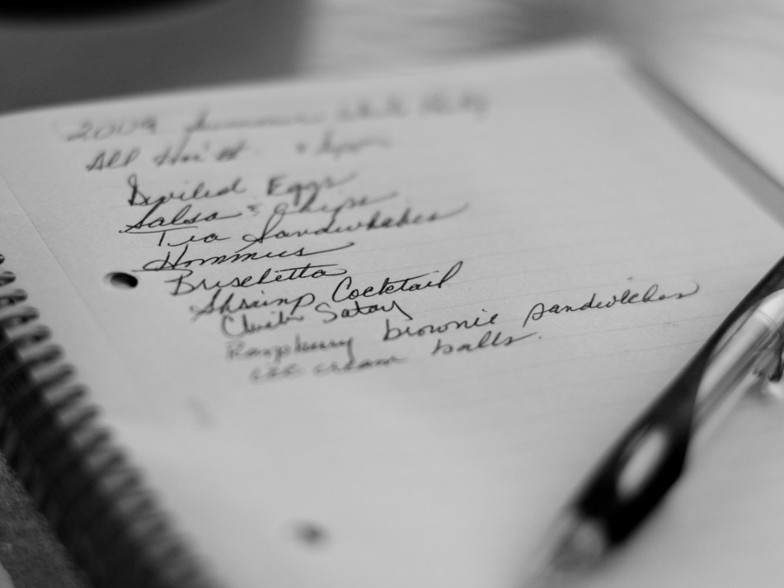
Lists July 7, 2021

Slide 2
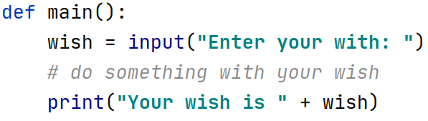

Slide 3
Two wishes?

Slide 4
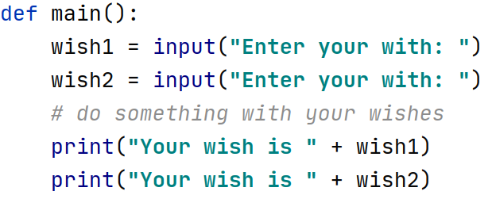

Slide 5
Ten wishes?

Slide 6
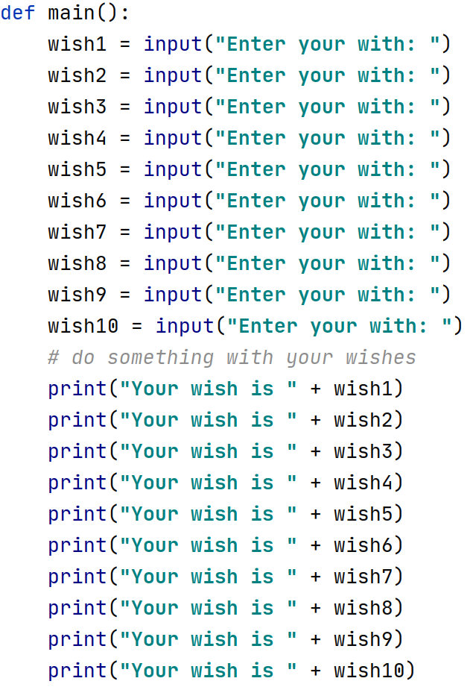

Slide 7
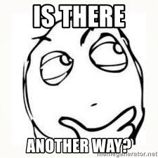

Slide 8
A list is way to keep track of an ordered collection of items
Items in the list are called "elements"
Ordered: can refer to elements by their position
Collection: list can contain multiple items
The list dynamically adjusts its size as elements are added or removed
Lists have a lot of built-in functionality to make using them more straightforward

Slide 9

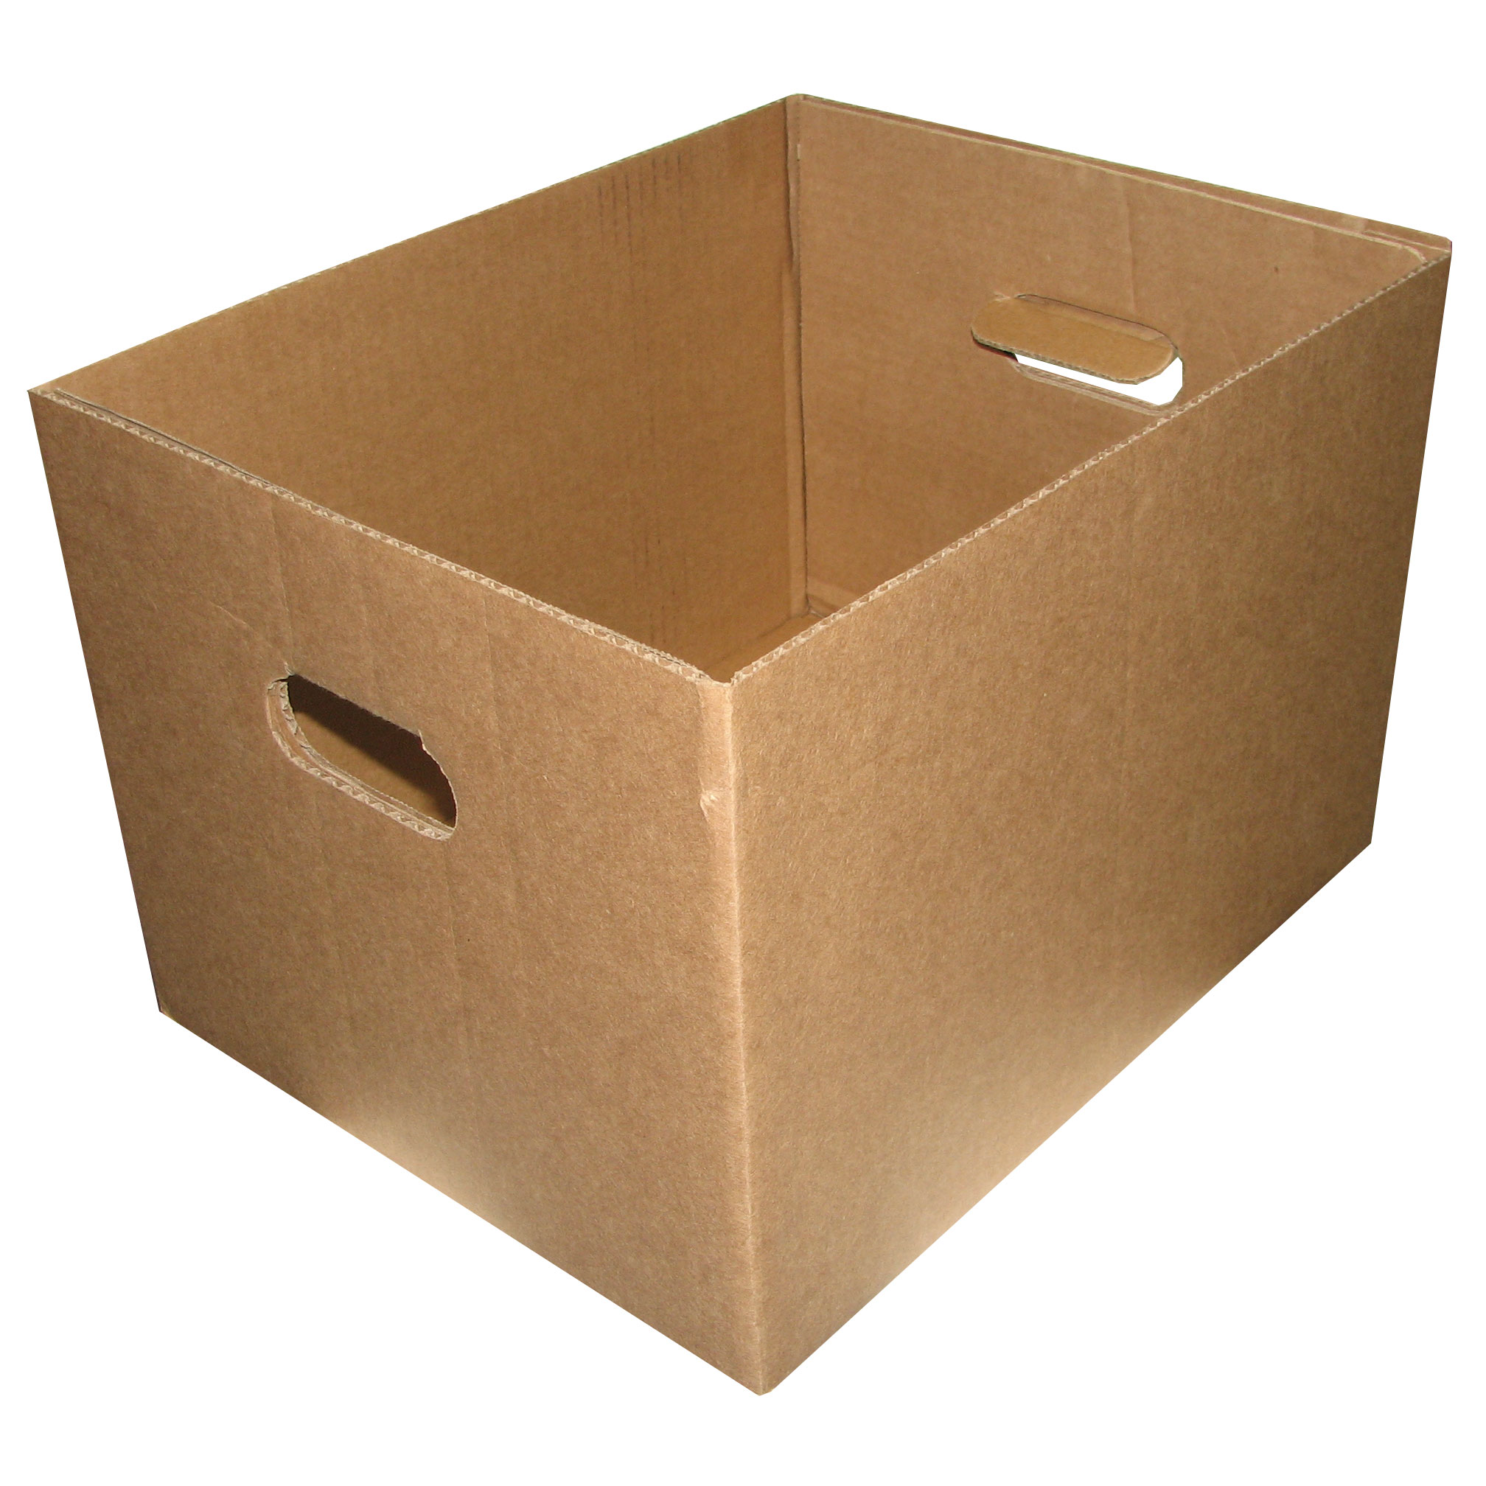
wish

Slide 10
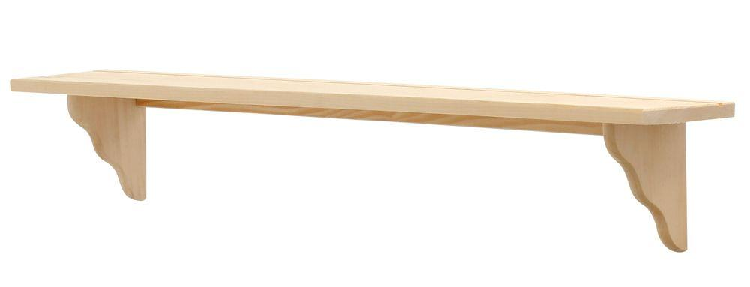

Slide 11
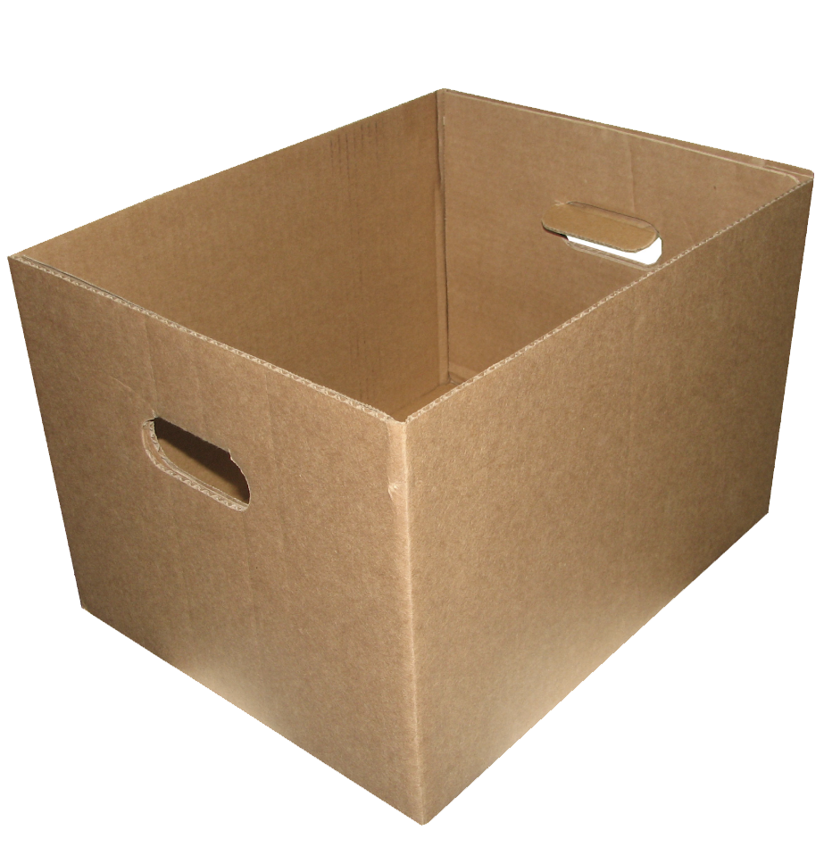

Slide 21
0
1
2
3
4
5
6
7
8
9

Slide 22
0
1
2
3
4
5
6
7
8
9

Slide 23
0
1
2
3
4
5
6
7
8
9

Slide 24
0
1
2
3
4
5
6
7
8

Slide 25
0
1
2
3
4
5
6
7

Slide 26
0
1
2
3
4
5
6
7
8
9

Slide 27
0
1
2
3
4
5
6
7
8
9

Slide 28
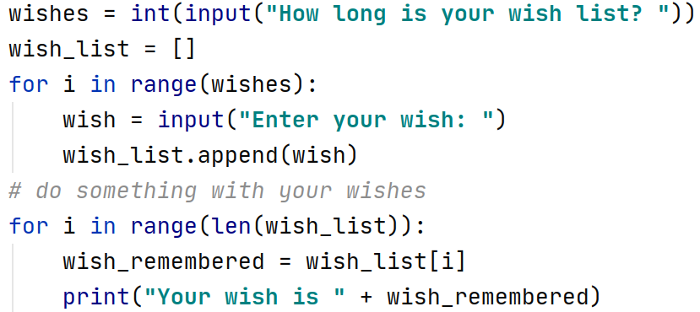

Slide 32
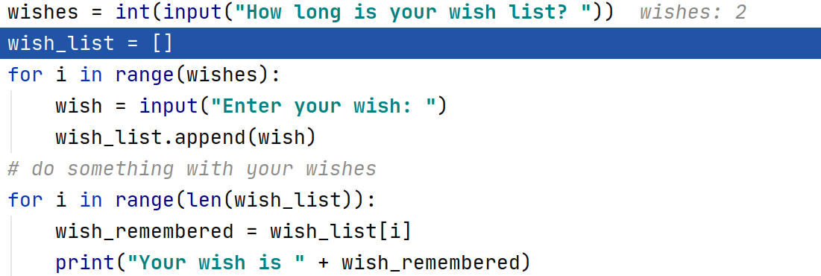

Slide 33
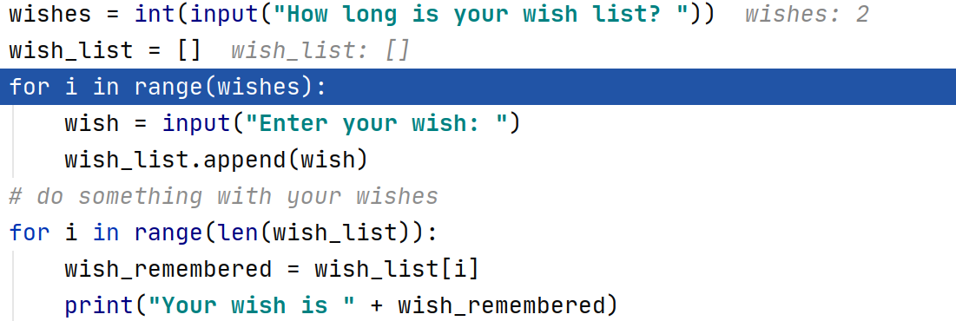

Slide 34
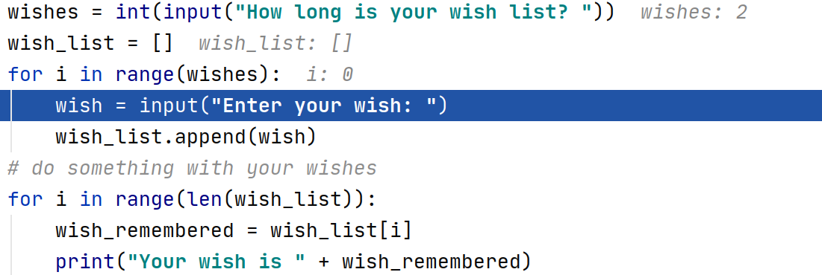

Slide 35
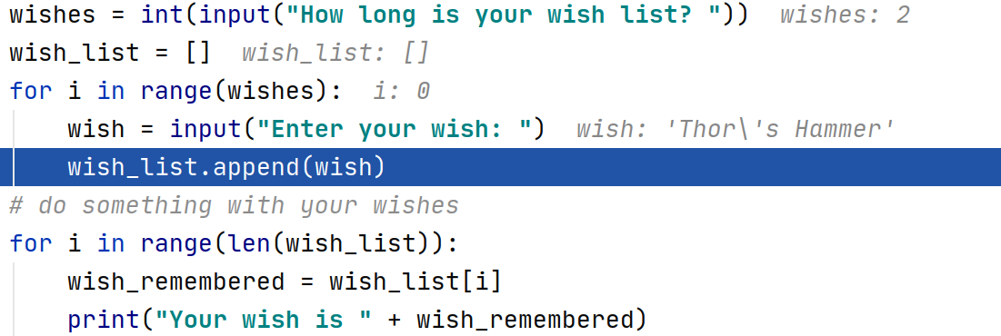

Slide 36
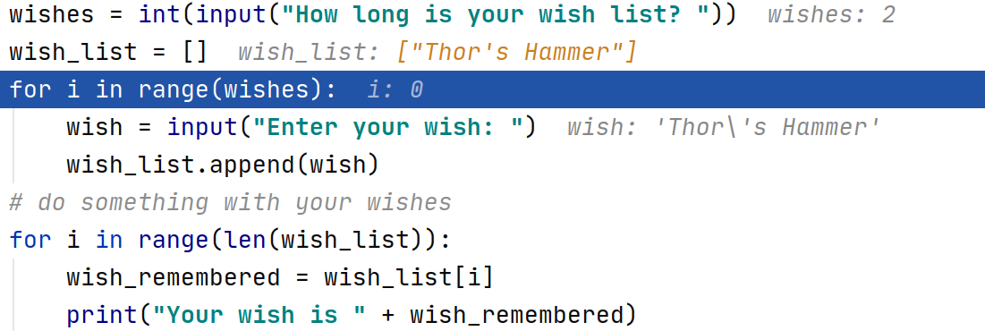
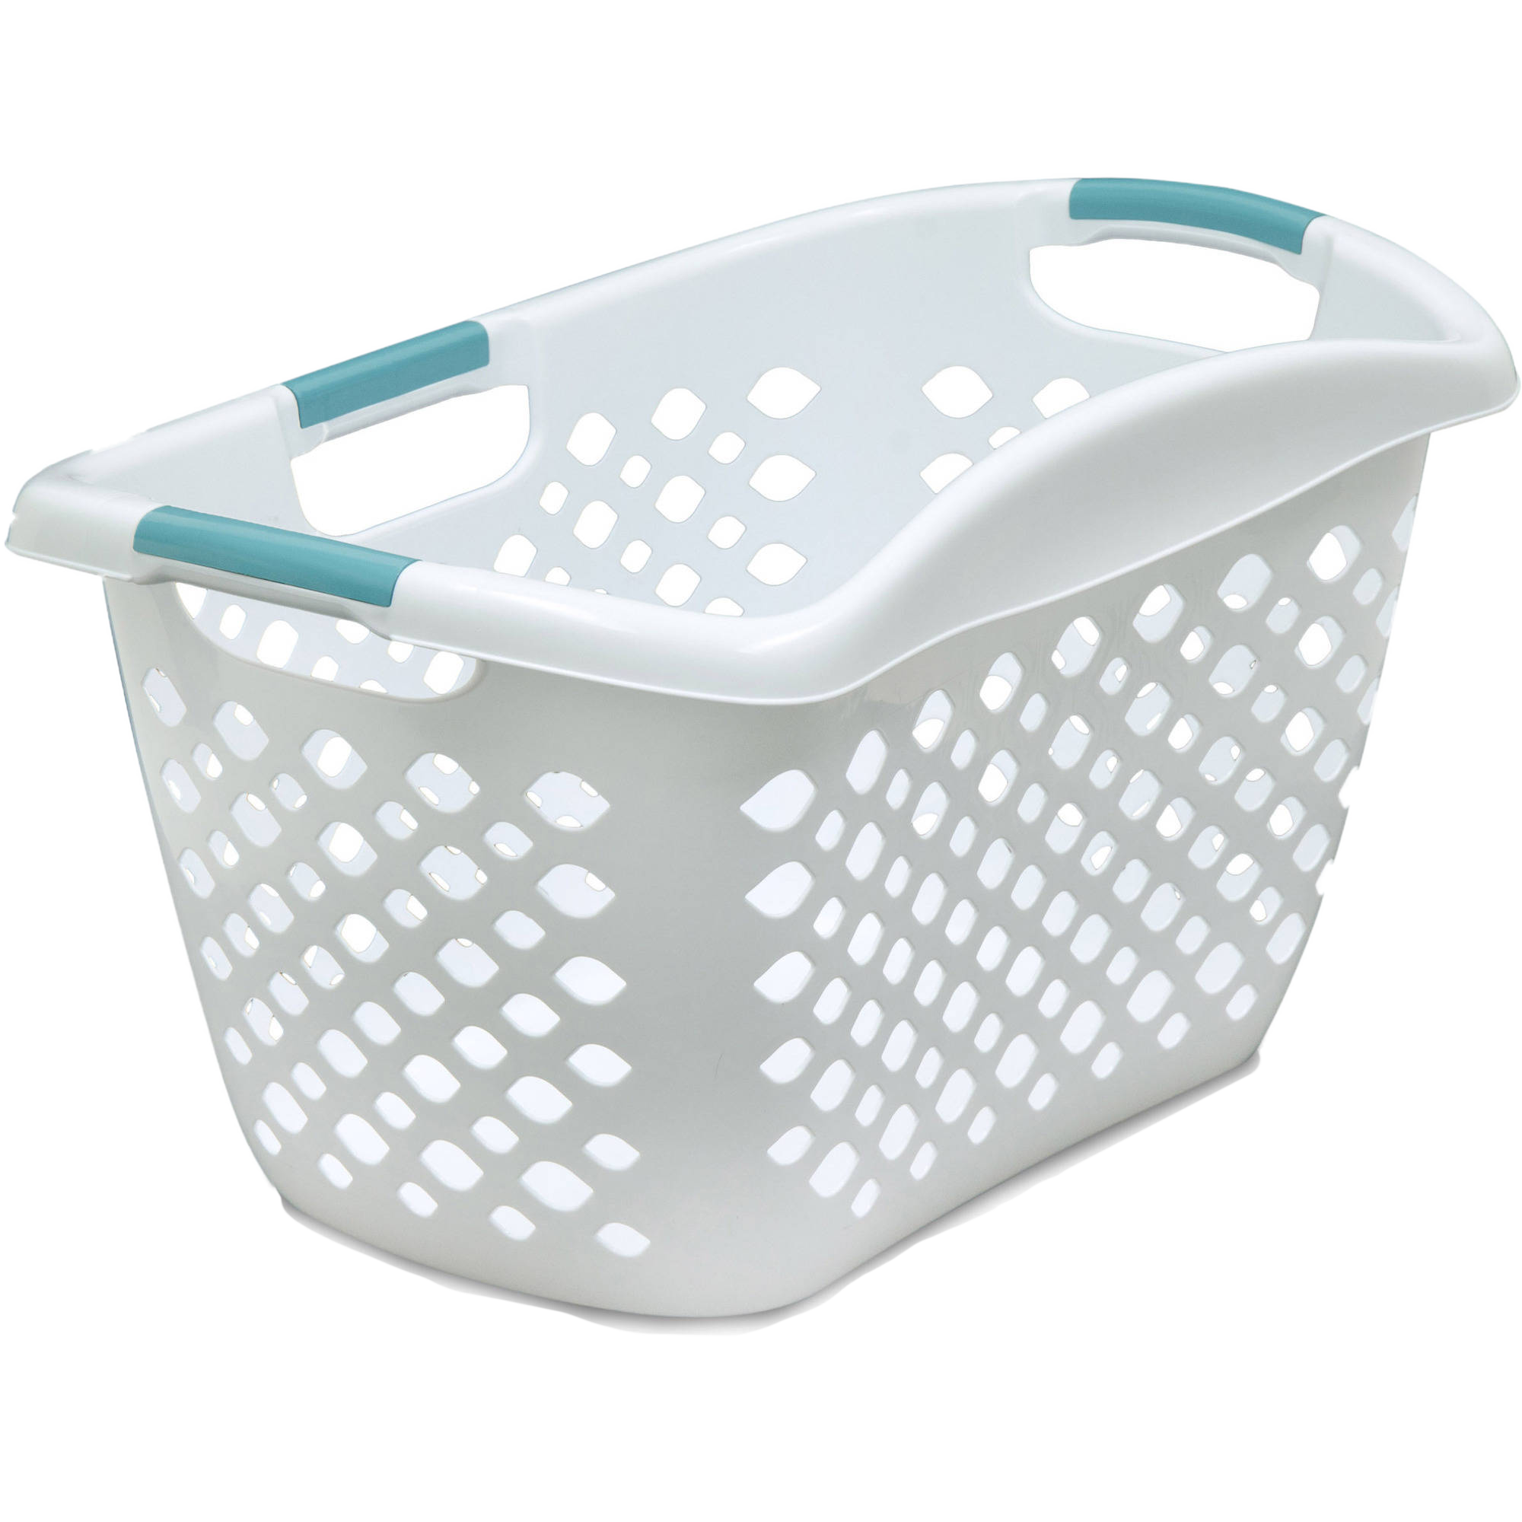
“Thor’s
Hammer”
0

Slide 37
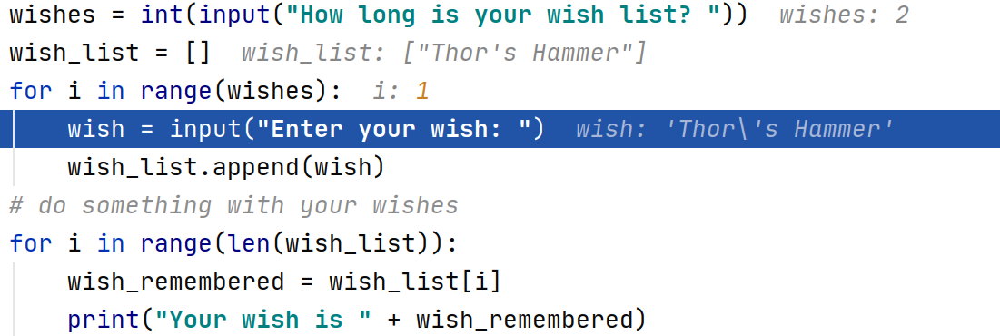
“Thor’s
Hammer”
0

Slide 38
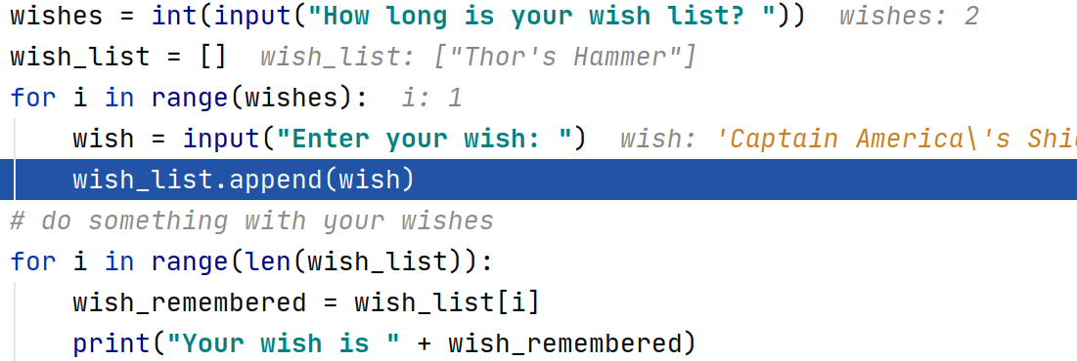
“Thor’s
Hammer”
0

Slide 39
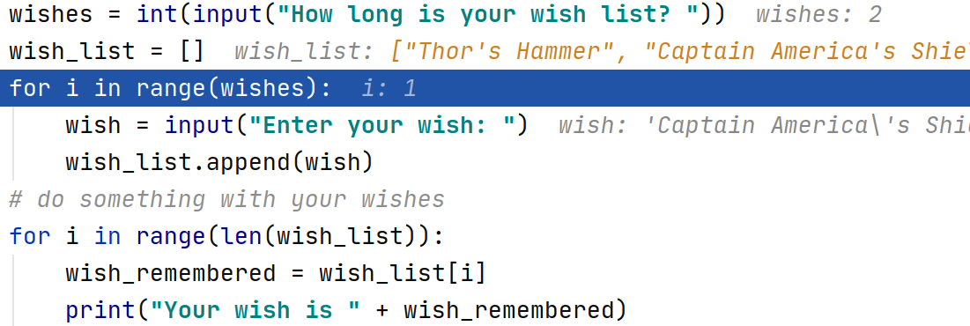
“Thor’s
Hammer”
“Captain
America’s
Shield”
0
1

Slide 40
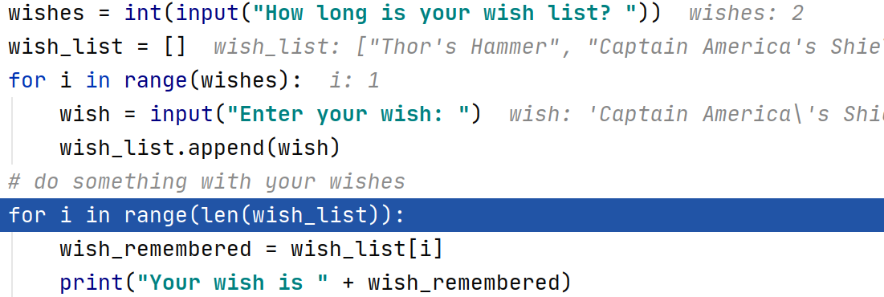
“Thor’s
Hammer”
“Captain
America’s
Shield”
0
1

Slide 41
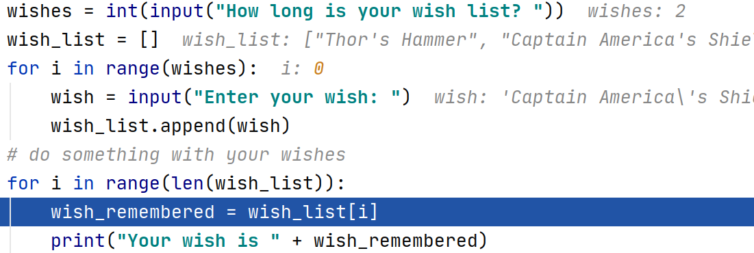
“Thor’s
Hammer”
“Captain
America’s
Shield”
0
1

Slide 42
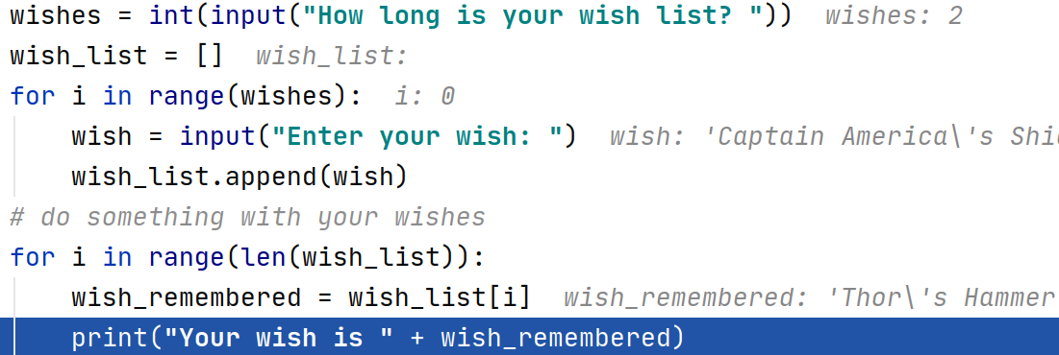
“Thor’s
Hammer”
“Captain
America’s
Shield”
0
1

Slide 43
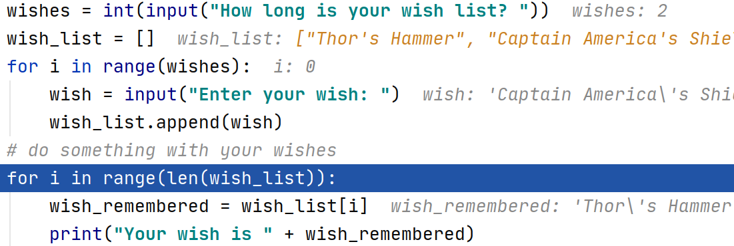
“Thor’s
Hammer”
“Captain
America’s
Shield”
0
1

Slide 44
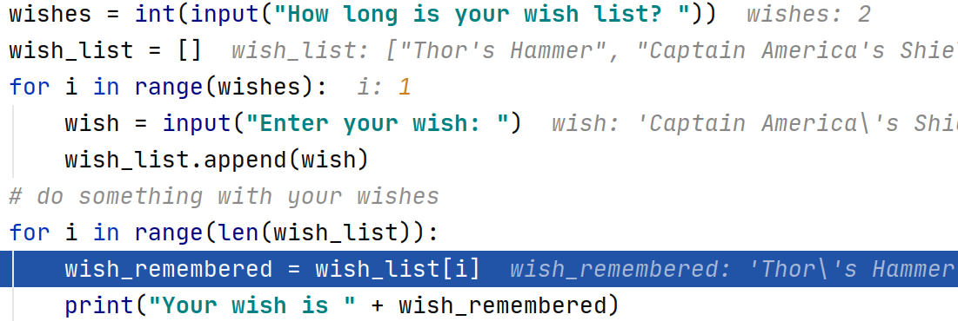
“Thor’s
Hammer”
“Captain
America’s
Shield”
0
1

Slide 45
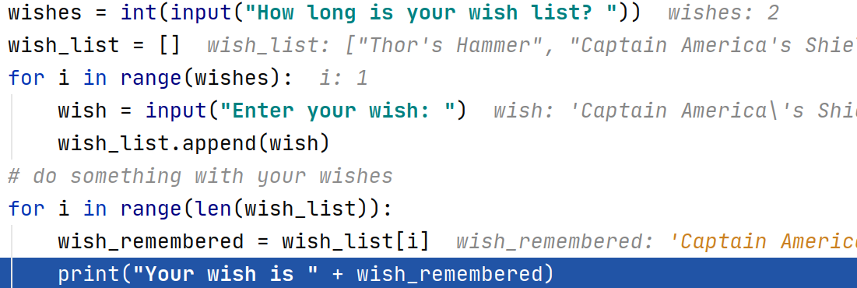
“Thor’s
Hammer”
“Captain
America’s
Shield”
0
1

Slide 46
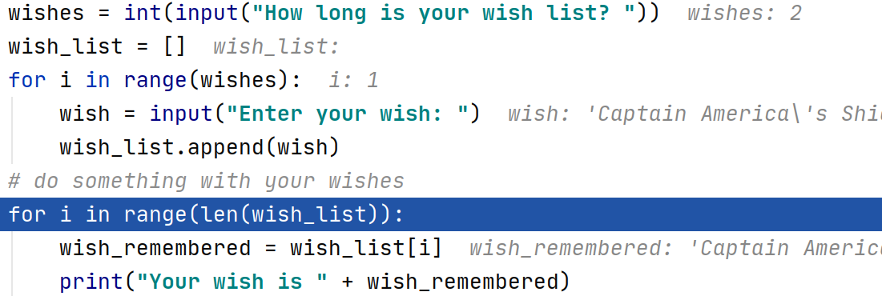
“Thor’s
Hammer”
“Captain
America’s
Shield”
0
1

Slide 47
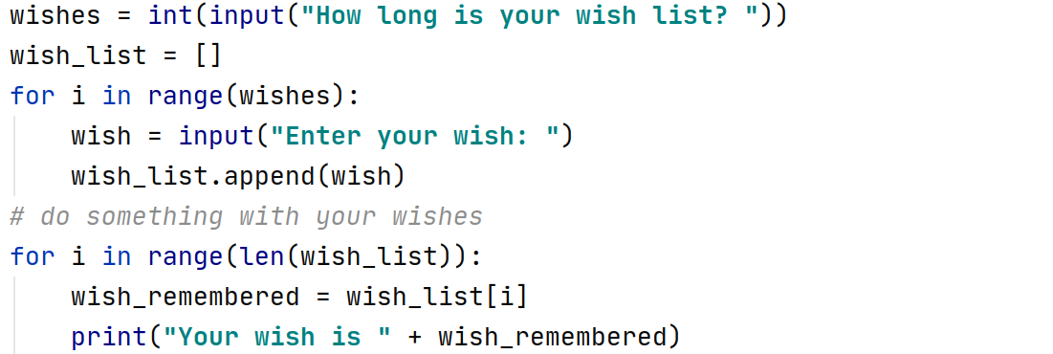
“Thor’s
Hammer”
“Captain
America’s
Shield”
0
1

Slide 48
More fun with lists

Slide 49
“Thor’s
Hammer”
“Captain
America’s
Shield”
0
1

Slide 50
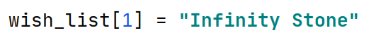
“Thor’s
Hammer”
“Captain
America’s
Shield”
0
1
“Thor’s
Hammer”
“Infinity Stone”
0
1

Slide 51
“Thor’s
Hammer”
“Infinity Stone”
0
1
“Thor’s
Hammer”
“Captain America’s Shield”
“Infinity Stone”
0
1
2

Slide 52
“Thor’s
Hammer”
“Captain America’s Shield”
“Infinity Stone”
0
1
2
Captain America’s Shield
“Thor’s
Hammer”
“Infinity Stone”
0
1

Slide 53
“Thor’s
Hammer”
“Infinity Stone”
0
1
“Thor’s
Hammer”
0
Remove the first matching element

Slide 54
“Thor’s
Hammer”
0
Thor’s Hammer

Slide 55
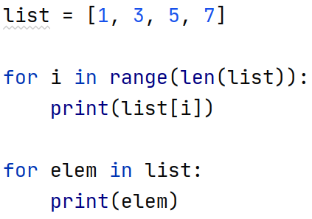

Slide 56
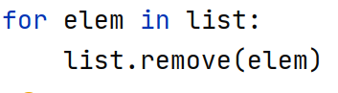
Cannot remove an element with remove. Use remove to remove the first occurrence of a value. To remove the first element of list with value “rabbit” do list.remove(“rabbit”)

Slide 57
Use remove to remove the first occurrence of a value. To remove the first element of list with value “rabbit” do list.remove(“rabbit”)
The above will get an error if you have no elements with a value of “rabbit”.
Note a list can contain duplicate elements. To get the count of elements with value “rabbit” do
num_rabbits = my_list.count(“rabbit”)
To delete the first element of list do
del list[0]
To get the second element of a list do
my_second_element = list[1]
To get and remove the second element of a list do
my_second_element = list.pop(1)
The above will get an error if a list has less than two elements. To get the size of a list do
my_size = len(my_list)
To append an element “dog” to a list do
my_list.append(“dog”)
To insert an element “cat” as the new second element do
my_list.insert(1, “cat”)
To reset the value of the second element do
my_list[1] = “kitty”
A list can contain elements of different types, and duplicates, for example
my_list = [“rabbit”, “rabbit”, “burrito”, True, False, 3, 7, 5.3, 10.0]

Slide 58
Lists
len(list) – get the length of a list
list.append(elem) – add elem to the end
list[i] - get ith element
list[i] = elem – set ith element to elem
list.insert(i, elem) – insert elem at ith index
list.remove(elem) – remove first occurrence of elem
list.count(elem) – get number occurrences of elem
list.pop(i) – get and remove ith elem
del list[i] - remove ith element
list.clear() – remove all elements from the list
list.index(elem) – get index of elem in the list

Slide 59
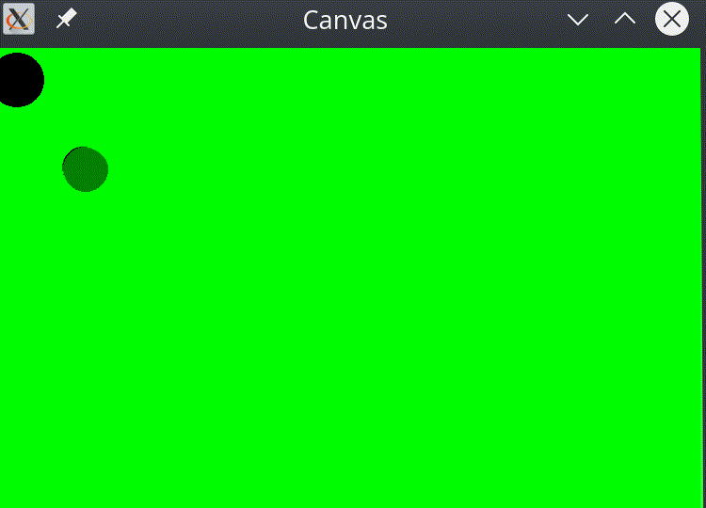

Slide 60
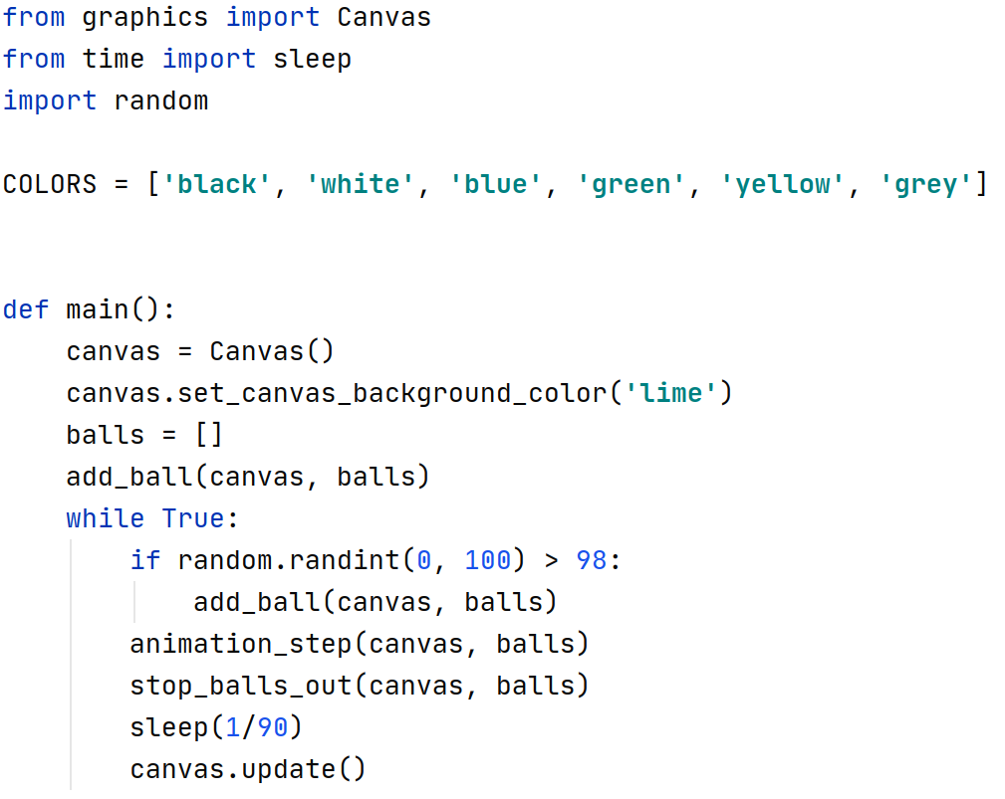

Slide 62
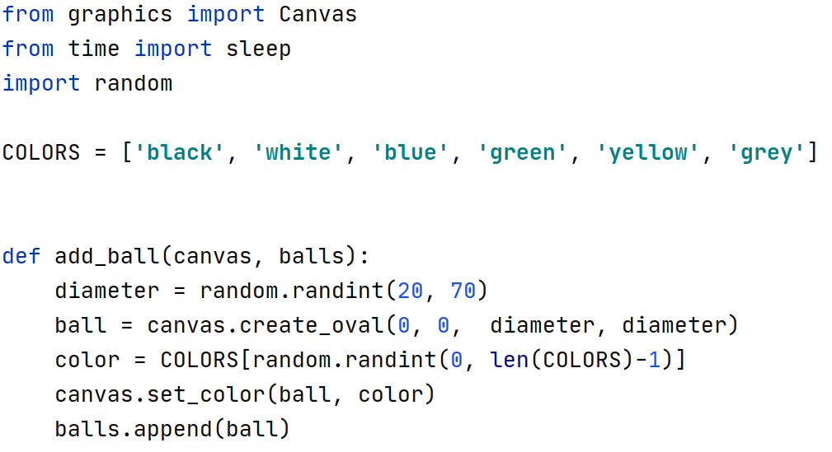

Slide 65
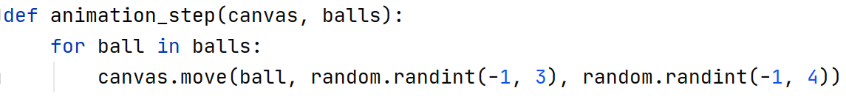

Slide 67
